Slide 1
Horizon Hotels
Jack Douet 21025153

Slide 2
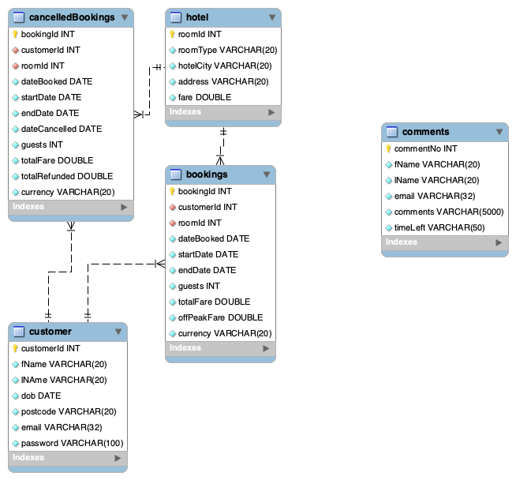
Database Design

Slide 3
Database Design Explanation
1st Normal Form
Made sure that there was only a single value, composite cells in each cell. For example, I made it so that payment amount and payment currency were two separate cells instead of being combined into one.
2nd Normal Form
Then ensured I was not relying on partial dependencies between my tables I did this by splitting booking information from the customer table.
3rd Normal Form
Finally, I removed transitive dependencies so that only the primary or composite primary key could be used to identify the rest of the fields for a particular row.
Other comments
I added in an additional table, comments, for storing user comments, perhaps if I had longer this would be sent to an email address linked to the admin user account or if on a production scale, sent to the company’s admin staff.
I chose to store all prices as doubles instead of integers because I realised that I would not always get a round number when they were multiplied by discounts or other operations. This is true for all prices, even initial prices which are mostly round numbers.

Slide 4

Legal, Ethical, Social and Professional Issues (LESP)

Slide 5
Legal
Made sure to adhere to GDPR data regulations. Encrypted all passwords entered by the user in case of a data breach or SQL attacks. I did this by creating a secret key and using sha245_crypt to turn the password into a hash which is then inputted into the table.
I have a terms and conditions page which can be accessed from any page on the website so that Users can always remind themselves of how we are treating their data and what they are agreeing to by using the service.
I used no external logos so do not need to worry about copyright law in terms of trademarks.
All images used on the site are free stock images that I have found online and are able to be used under a license of the site used, I have included links to all of the images used on the next slide.

Slide 6
Stock Images Used
https://www.istockphoto.com/photo/aberdeen-city-centre-gm513230938-87491807
https://unsplash.com/photos/OdQuwJulLLU
https://unsplash.com/photos/sU0SltsPDJ8
https://unsplash.com/photos/S56zN8cV5fk
https://unsplash.com/photos/gndl-el3n00
https://unsplash.com/photos/iXqTqC-f6jI
https://unsplash.com/photos/sIcAcPOgpMU
https://unsplash.com/photos/AuVELY4PpcU
https://unsplash.com/photos/_yvKqFYykeY
https://unsplash.com/photos/Mpek_xpTcTU
https://unsplash.com/photos/dmUolHCEHfk
https://unsplash.com/photos/s-zRJ3ySAYo
https://unsplash.com/photos/vOHs3ZvSczk

Slide 7
Ethical
Although not currently hosted anywhere, if I were in charge of choosing where the server was hosted I would insist on using a host who relies on cleaner forms of energy, I feel that this is something that will increasingly become more of an issue with server hosting in the future and could lead to an increase in the price of hosting or public outcry.
On the point of carbon footprints, I have realised that my additional table, cancelledbookings, is slightly unnecessary and could quite easily be a column on the bookings table. If my website was rolled out on a production scale, having this extra table would mean that the operating of the website would take up a lot more data than if done otherwise.
I have not asked the user whether they are comfortable with their data being shared around so I will not be doing that.
From the terms & conditions page we have consent from the user to take their personal data so that they can create an account and book with us.

Slide 8
Social
Having multiple view sizes accommodates a variety of users depending on what device they are using to view the website. Having three sizes allows users with any sort of online connected device to be able to book with us.
I made a conscious decision to have a lot of my text be quite big on the screen, I thought this would help improve readability.
I have added alt text to all pictures used so that if someone is using an accessible device such as a screen reader, they will still be able to use the website.
I have tried to make my website as easy to use as possible and the content of the website be accessible to all.

Slide 9
Professional
In my main file ’app.py’ I have put comments throughout to allow another programmer who views the source code the ability to understand exactly what each piece of code is doing. This would be helpful if instead of working on my own to create the website I was working on a larger team.
Although not required in the mark scheme, after I implemented any feature on the website I backed it up to GitHub, this was helpful as if I made mistakes and couldn’t quite work out what was causing the problem I could roll back to a previous commit and start fresh.
I feel that this is also a helpful skill to learn if I was working as part of a team as it forced me to summarise everything I was doing and why I was doing it.
Throughout the website I have tried to write nice-looking code, having good indentation throughout and following naming conventions of the different languages and technologies that I used.
I tried to be as secure as possible with non-admins accessing parts of the website that they should not, I chose to use a session variable called userType and then Python if and else statements within HTML files to check that the user was where they should be. If I were to start again I would use wrappers instead as I think that could be considered more secure.
I also created a generalised feedback/error page and then if anything went wrong I could feed in the error through a variable and the error message would be dynamically generated within an HTML page instead of crashing the code, in some instances, I used try-except statement blocks and sometimes I used if-else statements.

Slide 10
Testing
If ever deployed I would want my website to first be tested by alpha users in the form of fellow employees of the company I was working for and then beta tested with professional testers outside of the company. I would then use the comments form to monitor any problems that might crop up during real-world usage.
I have tried my website on multiple browsers and seems to work consistently across them all.
I have done a series of tests, shown on the next few slides are some examples.

Slide 11
Black-Box Tests
Test # | Test Area | Test Description | Expected Outcome | Data used (if applicable) | Outcome
1 | Login | Enter an incorrect password | User prompted to try again | User email Incorrect password | As expected
2 | Database Connection | Database turned off | User informed database is down | None | As expected
3 | Admin | Non admin trying to go on admin pages | User prompted that they do not have access | None | As expected

Slide 12
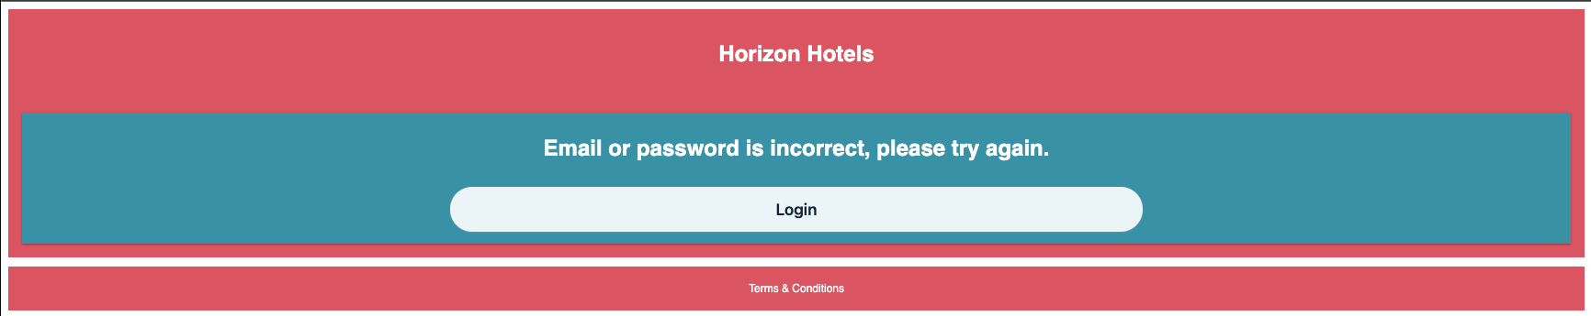
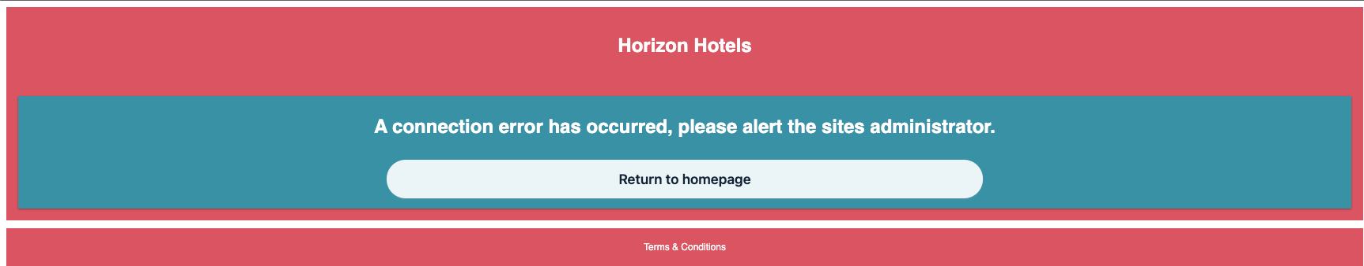
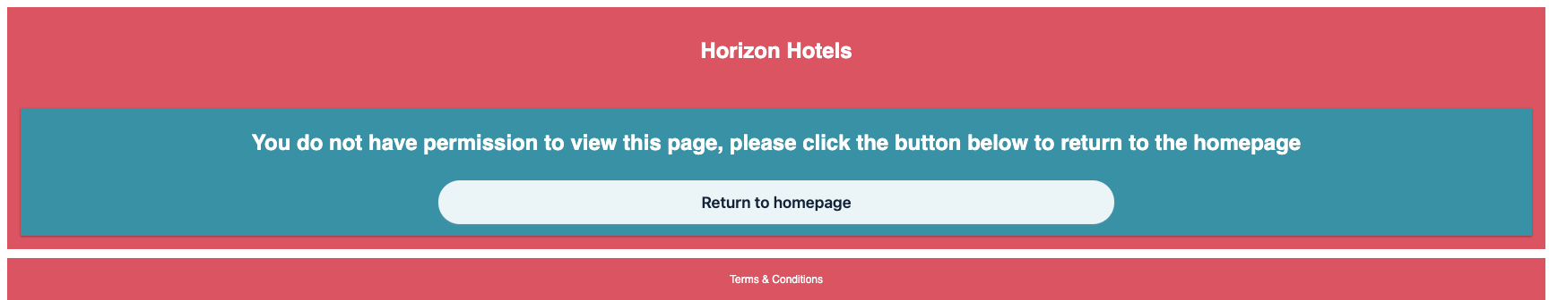
Black-Box Tests

Slide 13
Credit
Throughout my project, I have used various online sources, as well as the practical's for this module to guide my learning. I have taken the time to list some of the most helpful sources of information below.
Zaheer Khan’s practical resources.
W3 Schools
MYSQL Workbench documentation
Python documentation
Flask documentation
Stack Overflow
Medium
CSS-Tricks
Programiz
Python Basics
FreeCodeCamp

Slide 14
Evaluation
I managed to get all of the essential requirements listed in the first part of the assessment specification, I feel I have created an easy-to-use booking process which follows the spec as closely as I could get.
I have also added in some non-essential features at my own discretion such as a comments page or the terms and conditions. In addition to accepting payment in euros and dollars, I have also included pounds as a form of payment.
Given more time, I would have liked to work out email and payment handling but saw that it was outside the scope of this project.
I chose not to use bootstrap on this project because I wanted to become more familiar with the CSS behind a website instead of using preset classes and themes, this was a headache at times and definitely slowed me down but I am glad I did it. Next time though I think I would use it or some other framework.
As mentioned earlier on there were a couple of things that I chose to do my own way rather than how we were taught, i.e. error handling or page access permissions. These were probably not the ideal way to handle it but I am glad for the exercise in self teaching.
Again as mentioned earlier, I think that some of my database design could be refined and I think could have been better if I had a clearer picture of exactly what I would need for the project in terms of tables but I think perhaps that is something that will come with experience.
I am on the whole very happy with how my website has turned out and feel I have learnt a significant amount from undertaking this project.

